Slide 1
State Feedback Linearization
With example 9.2 (1)

Slide 2
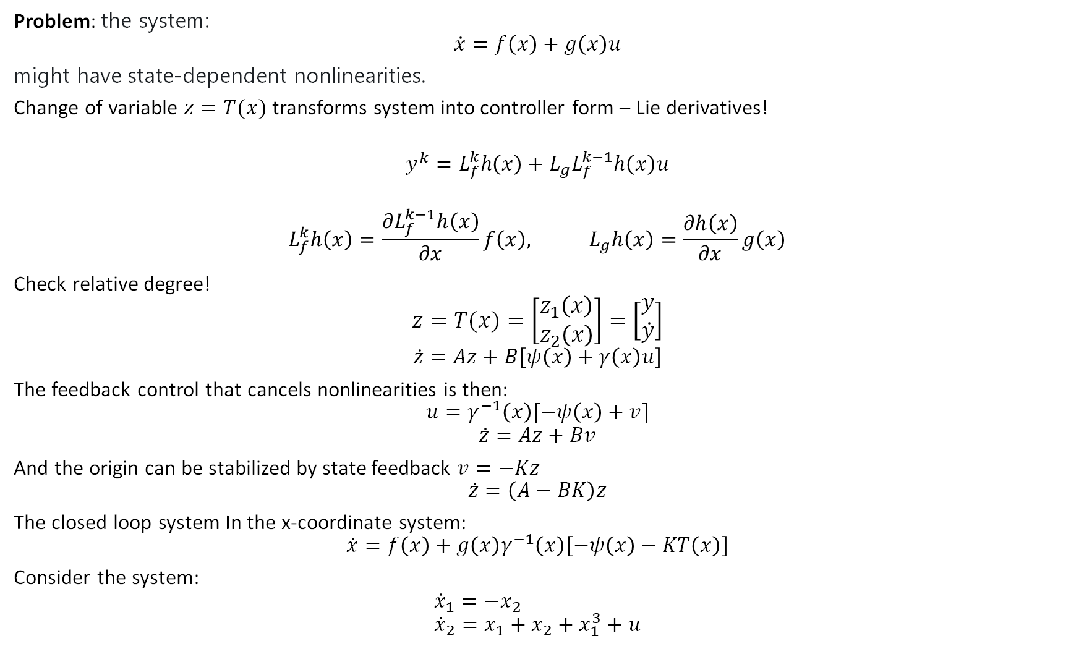
Problem: the system:
$$\dot{x}=f\left(x\right)+g\left(x\right)u$$
might have state-dependent nonlinearities.
Change of variable $z=T(x)$ transforms system into controller form – Lie derivatives!
$$y^{k}=L_{f}^{k}h\left(x\right)+L_{g}L_{f}^{k−1}h\left(x\right)u$$
$$L_{f}^{k}h\left(x\right)=\frac{∂L_{f}^{k−1}h\left(x\right)}{∂x}f\left(x\right), L_{g}h\left(x\right)=\frac{∂h\left(x\right)}{∂x}g\left(x\right)$$ Check relative degree!
$$z=T(x)=\left[\begin{matrix}z_{1}\left(x\right) \\ z_{2}\left(x\right)\end{matrix}\right]=\left[\begin{matrix}y \\ \dot{y}\end{matrix}\right]$$
$$\dot{z}=Az+B\left[ψ\left(x\right)+γ\left(x\right)u\right]$$
The feedback control that cancels nonlinearities is then:
$$u=γ^{−1}\left(x\right)[−ψ\left(x\right)+v]$$
$$\dot{z}=Az+Bv$$
And the origin can be stabilized by state feedback $v=−Kz$
$$\dot{z}=\left(A−BK\right)z$$
The closed loop system In the x-coordinate system:
$$\dot{x}=f\left(x\right)+g\left(x\right)γ^{−1}\left(x\right)\left[−ψ\left(x\right)−KT\left(x\right)\right]$$
Consider the system:
$${\dot{x}}_{1}=−x_{2} \\ {\dot{x}}_{2}=x_{1}+x_{2}+x_{1}^{3}+u$$

Slide 3

Consider the system:
$${\dot{x}}_{1}=−x_{2} \\ {\dot{x}}_{2}=x_{1}+x_{2}+x_{1}^{3}+u$$
$$\dot{z}=Az+B\left[ψ\left(z\right)+γ\left(z\right)u\right]$$
$$\dot{z}=\left[\begin{matrix}0 & −1 \\ 1 & 1\end{matrix}\right]\left[\begin{matrix}z_{1} \\ z_{2}\end{matrix}\right]+\left[\begin{matrix}0 \\ 1\end{matrix}\right]\left[z_{1}^{3}+u\right]$$
The feedback control that cancels nonlinearities is then:
$$u=γ^{−1}\left(z\right)\left[−ψ\left(z\right)+v\right] \\ =\frac{1}{1}\left[−z_{1}^{3}+v\right]$$
$$v=−kz$$

Slide 4
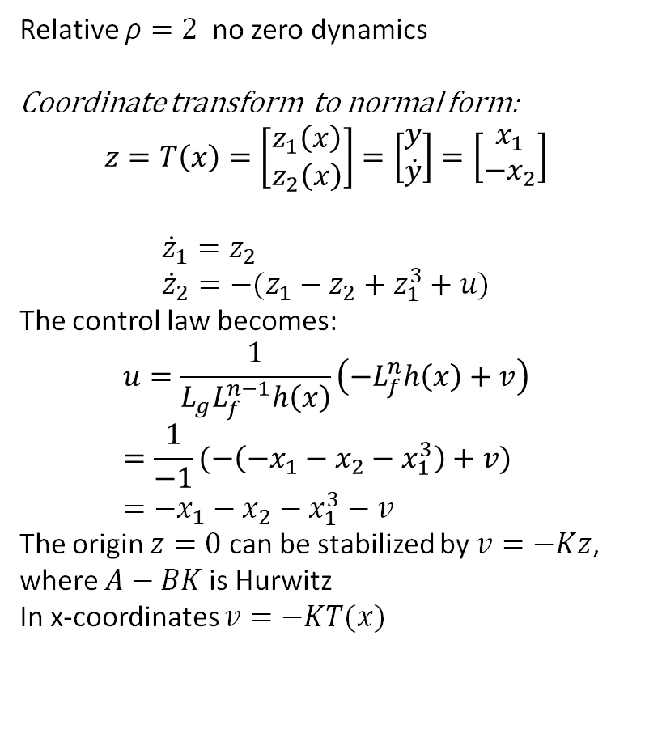
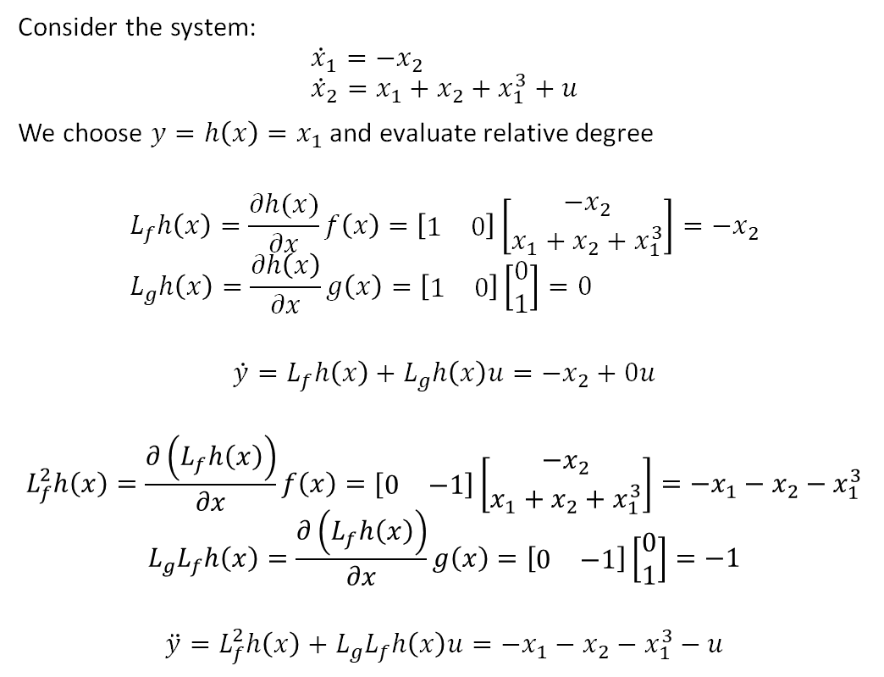
Example 9.2 (1)
Consider the system:
$${\dot{x}}_{1}=−x_{2} \\ {\dot{x}}_{2}=x_{1}+x_{2}+x_{1}^{3}+u$$
We choose $y=h\left(x\right)=x_{1}$ and evaluate relative degree
$$L_{f}h\left(x\right)=\frac{∂h(x)}{∂x}f\left(x\right)=\left[\begin{matrix}1 & 0\end{matrix}\right]\left[\begin{matrix}−x_{2} \\ x_{1}+x_{2}+x_{1}^{3}\end{matrix}\right]=−x_{2} \\ L_{g}h\left(x\right)=\frac{∂h\left(x\right)}{∂x}g\left(x\right)=\left[\begin{matrix}1 & 0\end{matrix}\right]\left[\begin{matrix}0 \\ 1\end{matrix}\right]=0$$
$$\dot{y}=L_{f}h\left(x\right)+L_{g}h\left(x\right)u=−x_{2}+0u$$
$$L_{f}^{2}h\left(x\right)=\frac{∂\left(L_{f}h\left(x\right)\right)}{∂x}f\left(x\right)=[\begin{matrix}0 & −1\end{matrix}]\left[\begin{matrix}−x_{2} \\ x_{1}+x_{2}+x_{1}^{3}\end{matrix}\right]=−x_{1}−x_{2}−x_{1}^{3}$$
$$L_{g}L_{f}h\left(x\right)=\frac{∂\left(L_{f}h\left(x\right)\right)}{∂x}g\left(x\right)=\left[\begin{matrix}0 & −1\end{matrix}\right]\left[\begin{matrix}0 \\ 1\end{matrix}\right]=−1$$
$$\ddot{y}=L_{f}^{2}h\left(x\right)+L_{g}L_{f}h\left(x\right)u=−x_{1}−x_{2}−x_{1}^{3}−u$$
Relative $ρ=2$ no zero dynamics
Coordinate transform to normal form:
$$z=T\left(x\right)=\left[\begin{matrix}z_{1}\left(x\right) \\ z_{2}\left(x\right)\end{matrix}\right]=\left[\begin{matrix}y \\ \dot{y}\end{matrix}\right]=\left[\begin{matrix}x_{1} \\ −x_{2}\end{matrix}\right]$$
$${\dot{z}}_{1}=z_{2} \\ {\dot{z}}_{2}=−(z_{1}−z_{2}+z_{1}^{3}+u)$$
The control law becomes:
$$u=\frac{1}{L_{g}L_{f}^{n−1}h\left(x\right)}\left(−L_{f}^{n}h\left(x\right)+v\right) \\ =\frac{1}{−1}(−\left(−x_{1}−x_{2}−x_{1}^{3}\right)+v) \\ =−x_{1}−x_{2}−x_{1}^{3}−v$$
The origin $z=0$ can be stabilized by $v=−Kz$, where $A−BK$is Hurwitz
In x-coordinates $v=−KT(x)$

